Slide 1
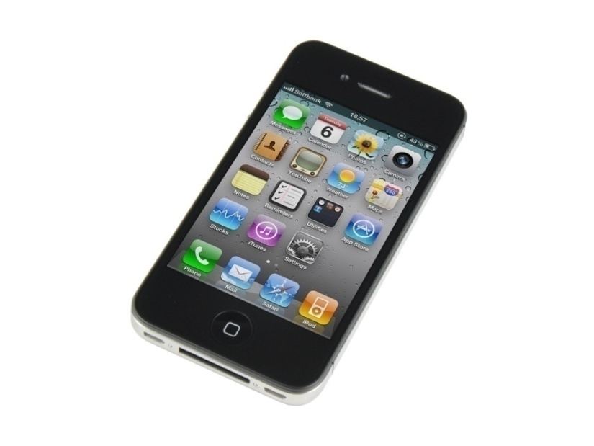
Exploring the buying behavior of consumers in the UAE based on the functionalities of smart phones
By:

Slide 2
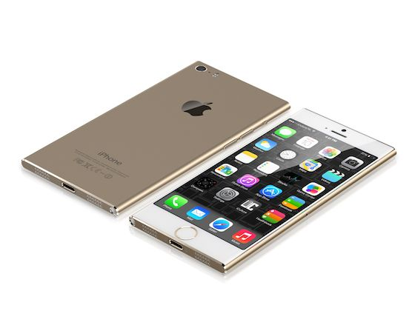
Introduction
When it comes to buying a Smartphone, the buyer considers several things like brand, technology, usability, price etc.
Social factors like family, peer groups, roles, social status and personal factors like age, lifestyle, personality, occupation and self esteem also affect the purchase decision of the buyer.
Smartphone market is expanding, hence it is imperial to study the consumer characteristics which assist in buying decision.
This study will assist industries to strategize their marketing mix and product mix according to the buyer behavior
It will serve as a base for many future researches in this area.

Slide 3
Literature review
Literature that has been reviewed based on Marketing, Consumer Behavior and study of the smartphone market from the internet, books, journals and periodicals.
A strong brand communicates to its customers that it is able to meet the customer’s needs and will continue to be accepted by consumers during states of high competition (Ettenson& Knowles, 2008).
Brand loyalty is the deeply held commitment to re buy or re-patronize a preferred product/service consistently in the future, thereby causing repetitive same-brand or same brand-set purchasing, despite situational influences and marketing efforts having the potential to cause switching behavior (Oliver, 1999). However, brand loyalty is not to be confused with repeat purchasing or habitual buying behavior.
Habitual buying behavior occurs when the consumer has no emotional attachment to the brand and buys the brand out of familiarity instead of brand conviction, but that this buying pattern can be broken if the availability of products has decreased or the price increases (Kotler, Armstrong, Saunders, and Wong,1996).
Brand loyal consumers have a conviction and an emotional attachment regarding the brand characterized by affection, passion, and connection (Kabirag & Shanmugan, 2011).
A consumer’s emotional attachment to the brand, the purchasing behavior, and the consumer’s social influences are three factors on which brand loyalty is dependent (Gounaris and Stathakopoulos, 2004).
When consumers identify with a product or company, they will have more of a tendency for repeat purchases and emotions will be formed resulting in brand loyalty (Halliday & Kuenzel, 2010).

Slide 4
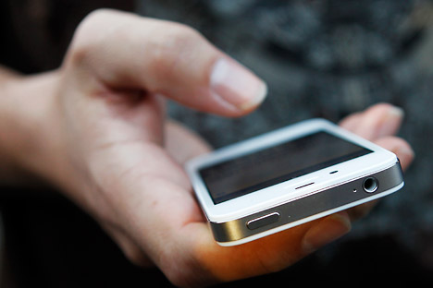
Research Objective
The research aims at knowing if peoples’ purchase of smartphones is motivated by their need or desire.
It will help to understand the factors that play a vital role in the purchase decisions of consumers.
It also discusses the effect of social status, culture and different promotional activities on the purchase decisions.

Slide 5
Methodology
This study involved qualitative research which has been executed by interviews with two focus groups to understand the answers to research questions.
By putting the people together in a focus group, they can be encouraged to respond each other’s comments and go beyond their initial response to a question (Kolb, 2008).
A permissive and nurturing environment is created by a moderator or interviewer that encourages different perceptions and points of view, without pressuring participants to vote, plan or reach consensus (Krueger and Casey, 2000).
Focus group 1 constituted of 4 males and 2 females and focus group 2 constituted of 5 males and 1 female; all in the age group of 20-30 yrs.
Both the focus group discussions were conducted in closed rooms on two different days and each of them lasted for an hour. The participants were clear in their opinions and the discussions remained active till the end.
Regulating the research standards is of paramount importance because it helps curb the data manipulation, privacy invasion and encourages the researcher to be honest (Dibb and Simkin, 2009).

Slide 6
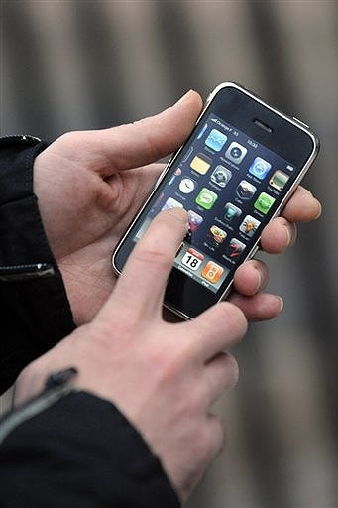
Findings and Analysis
Smartphone purchase reasons analysis:

Slide 7
Findings and Analysis
Analysing social characteristics’ effect on purchase

Slide 8
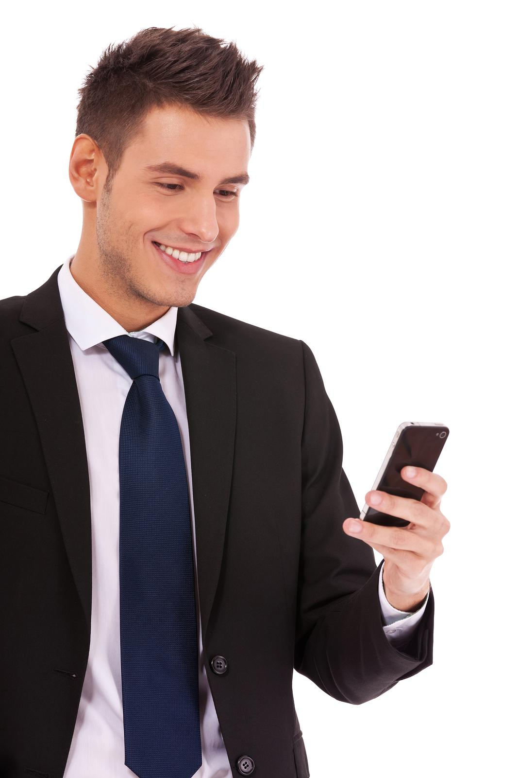
Findings and Analysis
Analysing personal characteristics’ effect on purchase

Slide 9
Findings and Analysis
Smartphone purpose analysis:

Slide 10
Findings and Analysis
Smartphone usage time analysis

